Slide 1
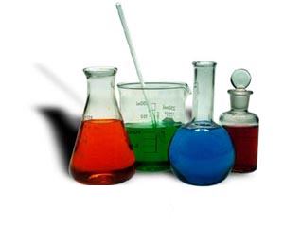
Notes on Total and Net Ionic Equations

Slide 2
Ionic Compounds
(Metal and Nonmetal)
(Cation and Anion)
If soluble these compounds will
DISSOLVE
and
DISSOCIATE (break apart into aqueous ions)
Examples:
CaCl_{2(aq)} → Ca⁺²_{(aq)} + 2Cl⁻¹_{(aq)}
Ba(NO₃)_{2(aq)} → Ba⁺²_{(aq)} + 2NO₃⁻¹_{(aq)}

Slide 3
Why write net-ionic equations?
To indicate the species actually involved in the chemical reaction.

Slide 4
For example,
Write the equation for the reaction of a solution of BaCl₂ with a solution of Na₂SO₄

Slide 5
Balance and ID the PPT
____Na₂SO_{4(aq)} + ____BaCl_{2(aq)} →
  _____ BaSO₄ + _____ NaCl

Slide 6
Dissociate all aqueous compounds
Re-write the equation:
2Na¹⁺_{(aq)} + SO₄²⁻_{(aq)} + Ba²⁺_{(aq)} + 2Cl¹⁻_{(aq)} →
  2Na¹⁺_{(aq)} + 2Cl¹⁻_{(aq)} + BaSO_{4(s)}

Slide 7
In writing a total ionic equation for reactions in water:
We indicate all soluble ionic materials
- substances that dissolve in water to form ions - as ions followed by (aq).
All insoluble ionic solids are written with (s) following their formula

Slide 8
We then note that:
Covalent compounds are written with their molecular formula.
In this equation, we note that the sodium and chloride ions are unchanged and are present on both sides of the equation.

Slide 9
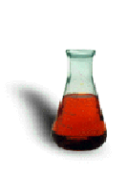
Since they are not undergoing chemical reaction, they can be referred to as spectator ions.
If we subtract the spectator ions from each side of the equation, we then have a net ionic equation

Slide 10
The net ionic equation for this reaction is:
Ba²⁺_{(aq)} + SO₄²⁻_{(aq)} → BaSO_{4(s)}
The net ionic equation is a statement of the chemistry that occurred, namely, aqueous barium 2+ ion reacted with aqueous sulfate ion to form solid barium sulfate.

Slide 11
Net ionic equations may also be written for replacement reactions.
Write the equation for the double replacement reaction of aqueous potassium iodide with lead (II) nitrate solution.

Slide 12
Total ionic equation for double replacement reactions.
Write the total ionic equation for the same reaction

Slide 13
Net ionic equations may also be written for replacement reactions.
Write the net ionic equation for the reaction.
Cross off the Spectator Ions

Slide 14
Dissociate all aqueous compounds
Re-write the equation:
Pb²⁺_{(aq)} + 2I¹⁻_{(aq)} →
  PbI_{2(s)}
The nitrate ion doesn’t take part in the reaction so it is considered the spectator ion here.

